Slide 1
Welcome!
Please, have a seat.
CWRU Quants
quants@case.edu
Notes:
Christo

Slide 2
Agenda
Administrative Information
Vertical Integration
Project Descriptions
Notes:
Christo

Slide 3
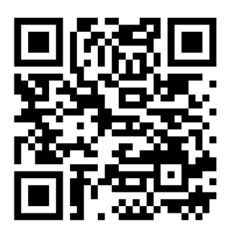
Attendance | CampusGroups
Notes:
Christo

Slide 4
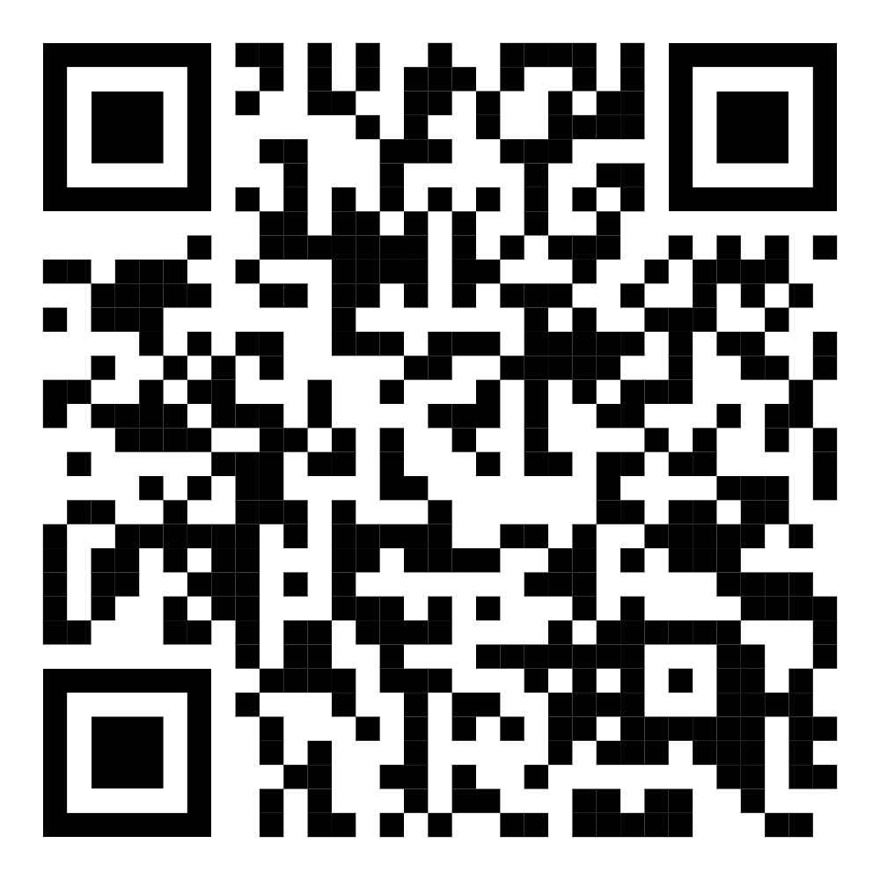
Discord (important!)
Notes:
Christo

Slide 5
Vertical Integration
Notes:
Ray

Slide 6
The Development Vertical
Quant developers, in general, develop software tools to facilitate research and trading. Examples include low-latency trading systems and data visualization software.
The Development vertical at CWRU Quants will work on a comprehensive backtesting framework that the Research and Trading verticals will use to backtest their strategies.
Experience in Python, competence with the popular data packages, and knowledge of basic financial mathematics would help in completing tasks related to this project.
Notes:
Ray

Slide 7
Goals
First and foremost is to provide non-software engineers quick, easy ways to crank out clear, informative financial charts!
Important: not a single backtesting framework out there (not counting internal tools at some firms) does this
Notes:
Ray

Slide 8
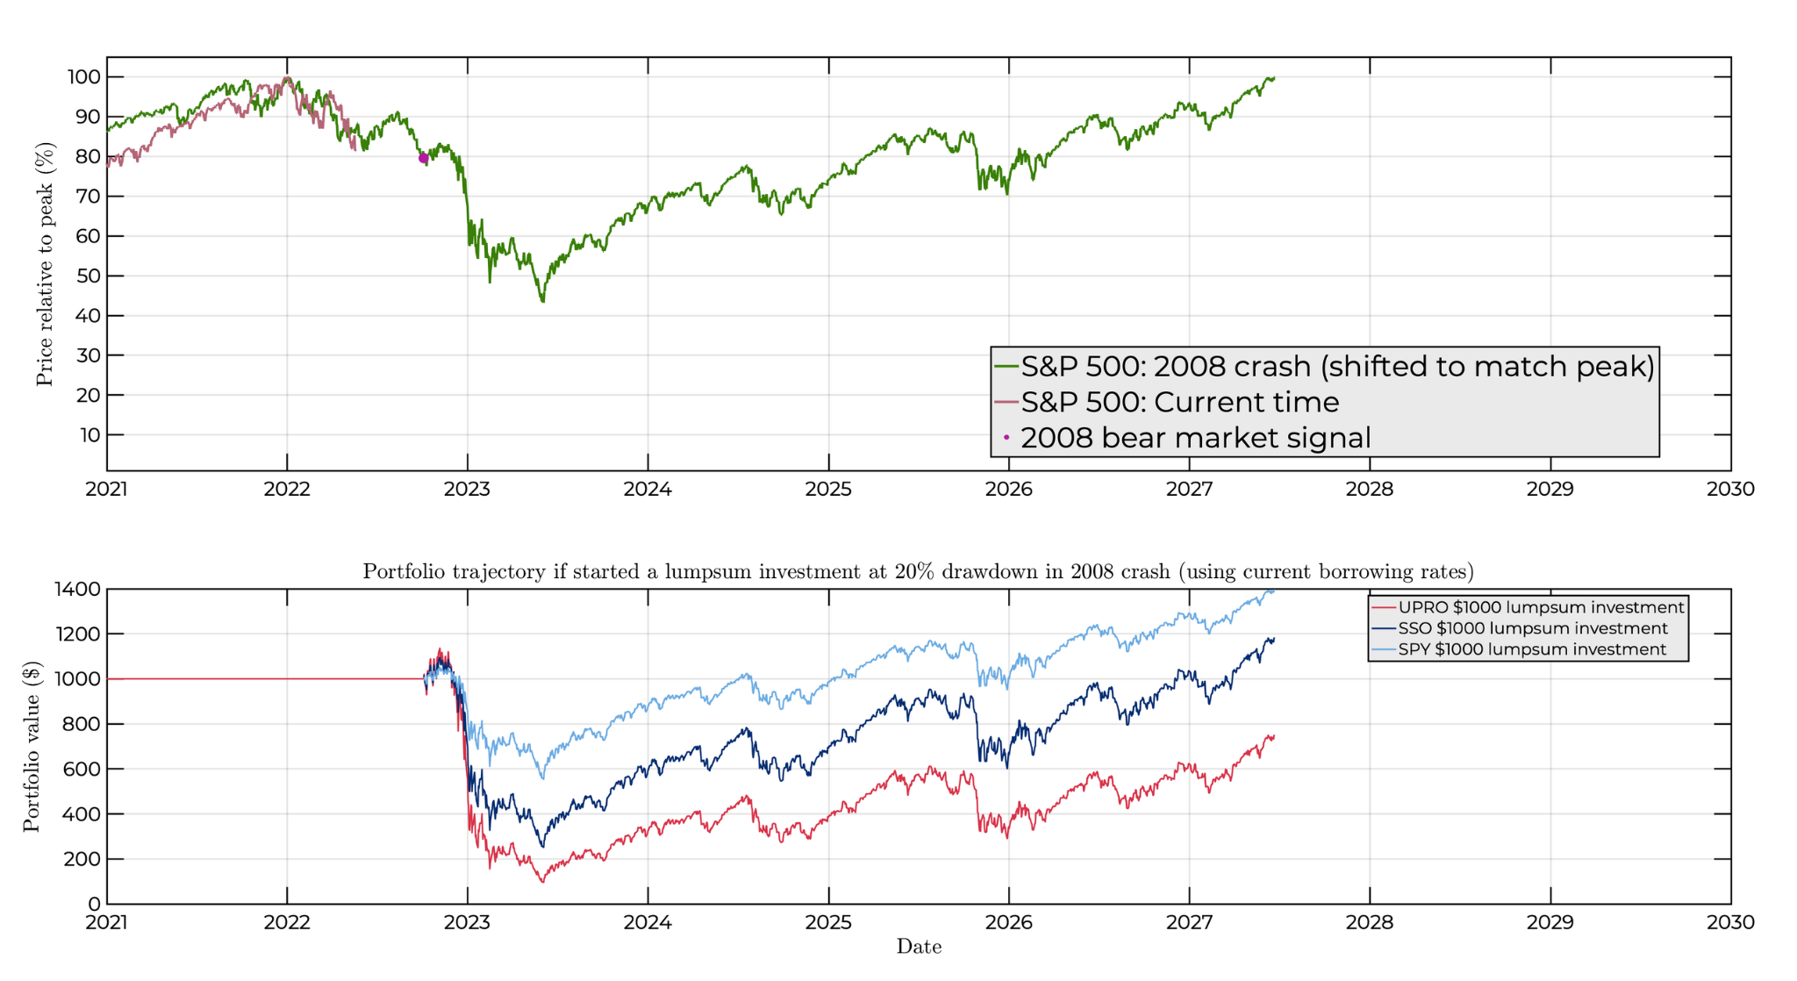
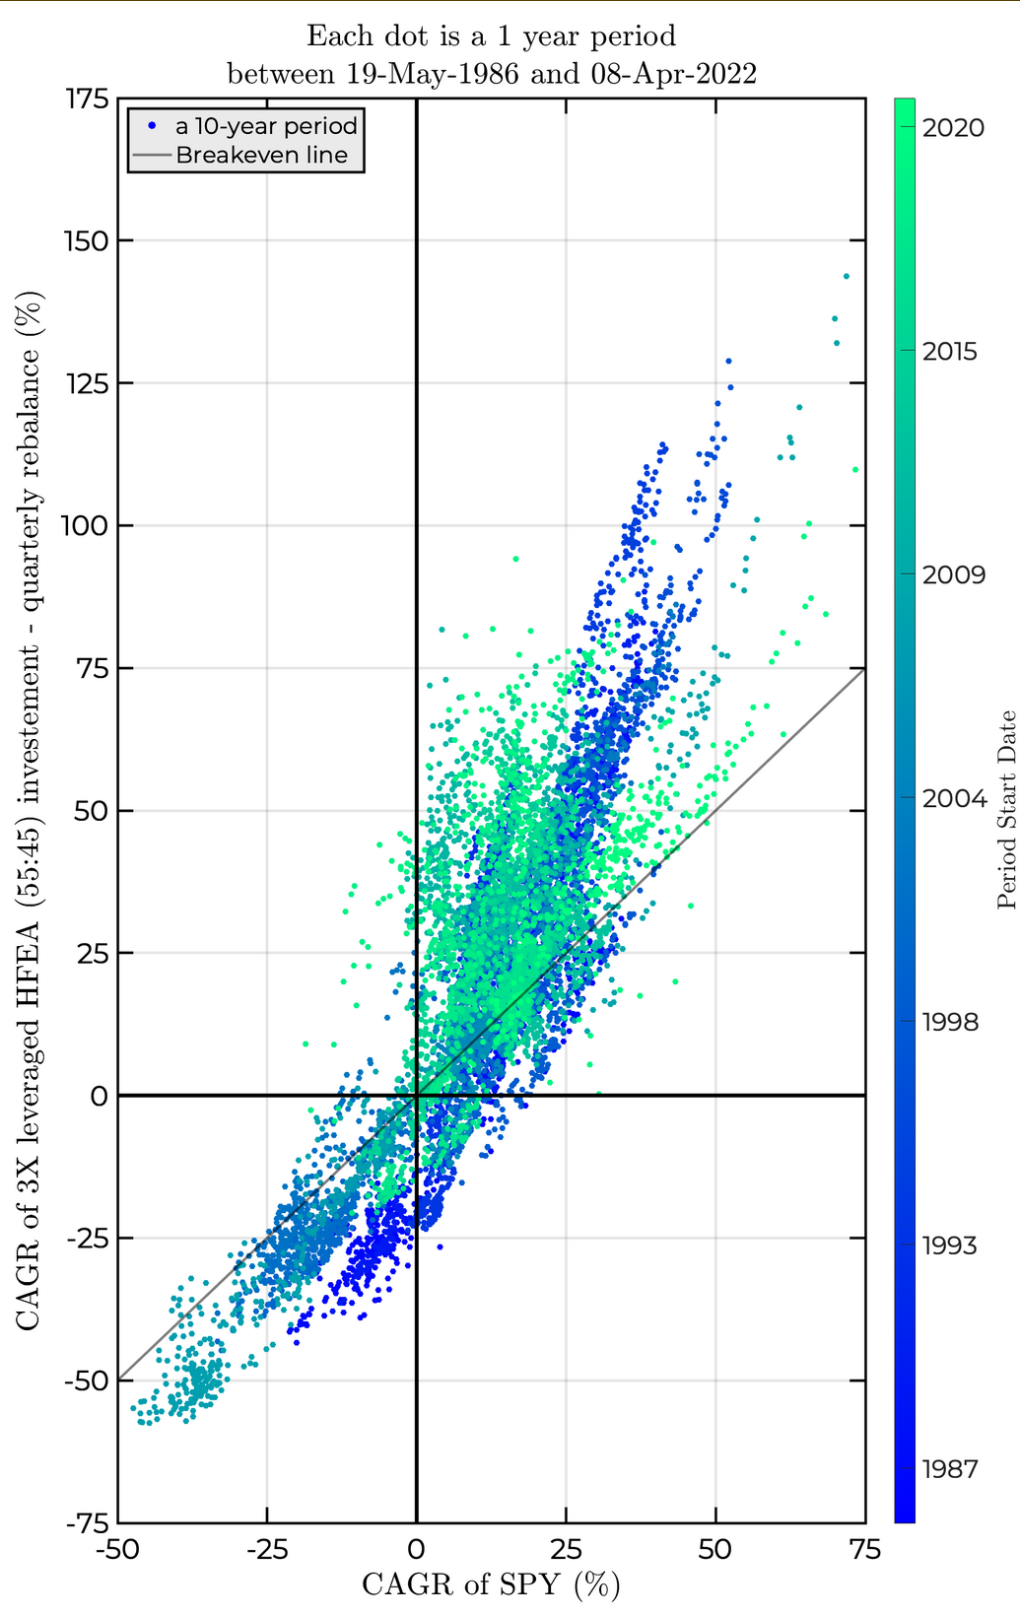
Notes:
Ray

Slide 9
Inspiration
The backtesting frameworks qstrader (https://github.com/mhallsmoore/qstrader/) and bt (https://pmorissette.github.io/bt/)
The algorithmic trading libraries basana (https://github.com/gbeced/basana) and pyalgotrade (https://github.com/gbeced/pyalgotrade)
Backtesting software that has already been distilled into website form, such as Portfolio Visualizer (https://www.portfoliovisualizer.com/backtest-portfolio) and Tradewell (https://www.tradewell.app/) (not free)
Notes:
Ray

Slide 10
Mechanism
Price, volume, and bid-ask spread data will be input into the framework
Traders/Researchers will be able to distill their strategies into trades over a certain time period using the strategy engine
A simulation engine will then simulate a portfolio as trades are made and asset prices change over time
On the periphery:
Charting and data visualization modules will generate the amazing charts shown earlier
Statistics regarding the trades and the portfolio will be calculated and shown to the user
Trade execution simulator will help the simulation engine make fills seem realistic, simulate slippage, etc
And more
Notes:
Ray

Slide 11
Interested?
The development vertical puts the highest emphasis on software engineering skills
Experience with Python is a must
Competence with the popular data packages is nice to have, but we’ll learn as we go
Knowledge of basic financial mathematics is also important to have
Notes:
Ray

Slide 12
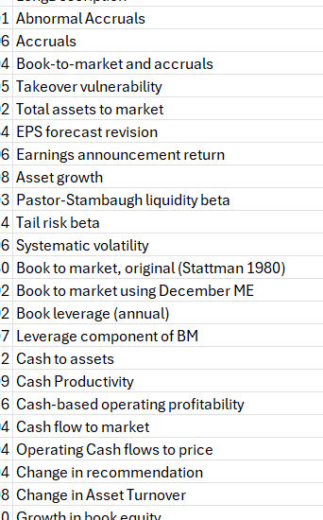
The Trading Vertical
Our goal will be to develop (profitable!) strategies
We have 212 already-established predictive signals
We also have the monthly returns, volume, shares outstanding, etc. of many stocks
Together, we will investigate what signals are the most effective (and in which industries too)
We will construct a strategy (portfolio?) based on this
Python will be helpful for the implementation and analysis (ML?)
SQL might be useful for querying (since these are large datasets)
Some financial background will be helpful for understanding the signals
Notes:
Christo

Slide 13
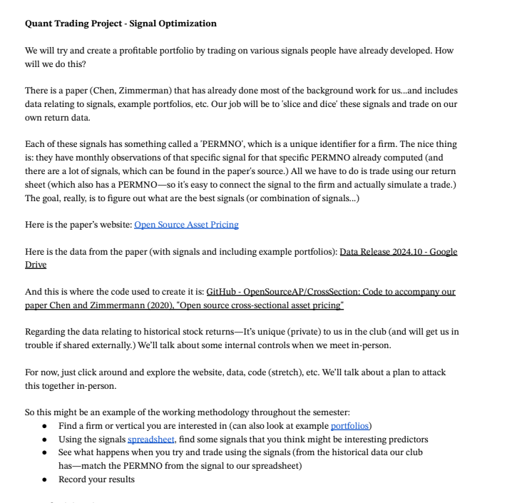

Slide 14
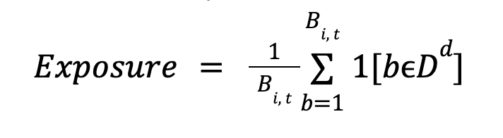
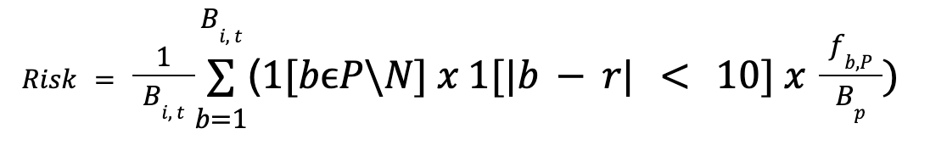
The Research Vertical
We will be analyzing quarterly earnings call transcripts from companies. There have been 2 previous papers published by Hassan et al. analyzing Political and Epidemic Disease exposure.
Notes:
Ethan
I think you guys should also look to develop some proprietary signals (to compare how good the ones we make are against the ones in the paper)
This can be a large portion if you need to be^
For example, scrape the linkedin posts of company management to get some signal
Or…get some sources of alternative data (like company management private jet logs) and see if there is any relation to company disclosures, stock price, etc.

Slide 15
QUESTIONS AND ANSWERS
Contact us!
Email: quants@case.edu
Instagram: @cwruquants

